Slide 1


SALES ANALYSIS OF A RETAIL COMPANY
FINAL PROJECT - 01

Slide 2




OBJECTIVE
DEVELOP AN INTERACTIVE DASHBOARD FOR TRACKING SALES PERFORMANCE AND TRENDS
ANALYZE CUSTOMER DEMOGRAPHICS TO INFORM TARGETED MARKETING STRATEGIES
EVALUATE PRODUCT PERFORMANCE TO OPTIMIZE INVENTORY AND BOOST SALES

Slide 3



OBJECTIVE
PERFORM PARETO ANALYSIS TO IDENTIFY TOP-SELLING PRODUCTS
SEGMENT CUSTOMERS BY AGE, GENDER, AND LOCATION FOR PERSONALIZED MARKETING
ASSESS THE IMPACT OF DISCOUNTS AND ORDER STATUS ON SALES AND REVENUE

Slide 4

DATA ANALYSIS

Slide 5
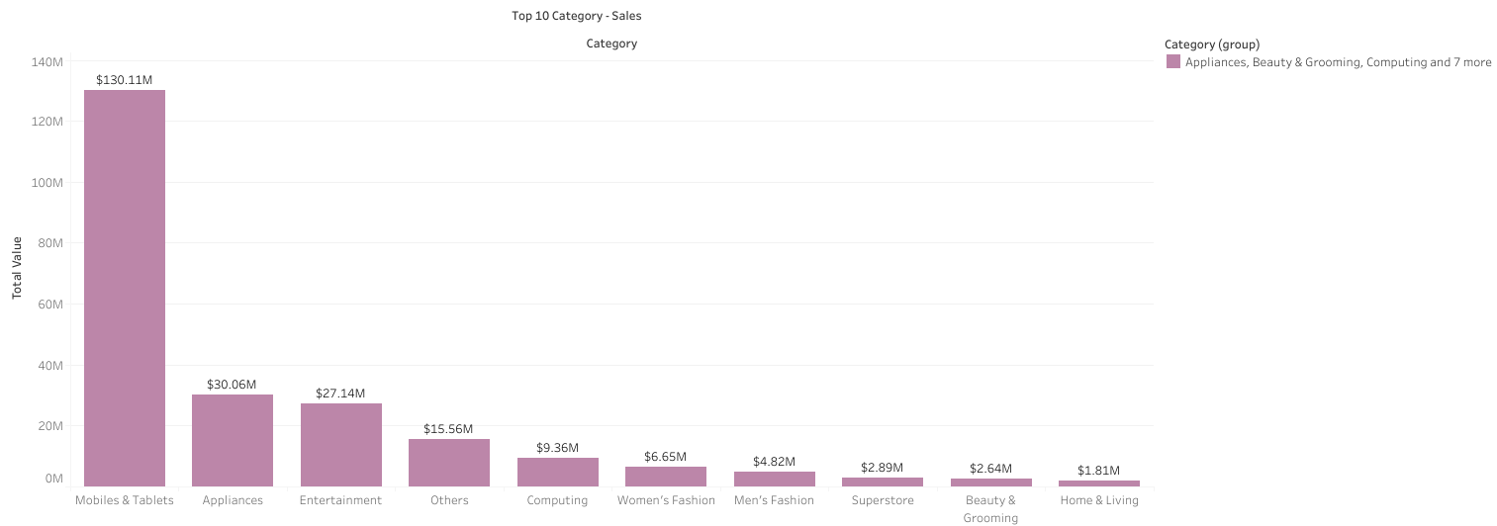

Slide 6


INSIGHTS
RECOMMENDATIONS
Mobiles and Tablets category drives the highest revenue, significantly outperforming other categories
Enhance promotions and discounts for Mobiles, Appliances, and Entertainment categories
Appliances and Entertainment are strong secondary categories worth further investment
Develop targeted marketing campaigns for Fashion and Beauty segments
Improve cross-selling opportunities between top-performing and lower-performing categories
Fashion and Beauty categories have lower sales but potential for growth

Slide 7
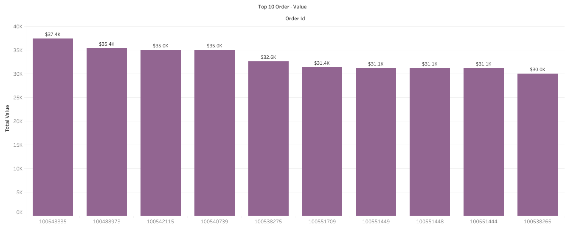

Slide 8
INSIGHTS
RECOMMENDATIONS
High-value orders are concentrated among a few top customers
Implement loyalty programs for high-value customers
Single large orders drive significant revenue from individual customers
Target top customers with personalized promotions
Few Customers tend to place high-value orders rather than frequent smaller purchases
Encourage repeat purchases with exclusive discounts and offers

Slide 9
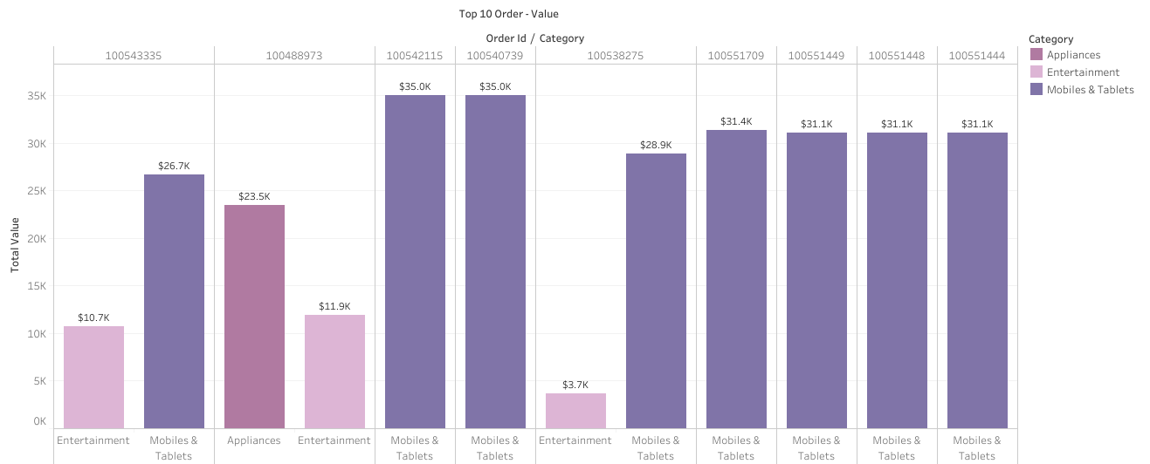

Slide 10
INSIGHTS
RECOMMENDATIONS
80% of top orders are from the category Mobile & Tablets, which indicates high demand
Offer personalized deals on Mobile & Tablets
Significant secondary purchases in Entertainment category, could be a possible sign of up-selling
Combine Entertainment products with high-demand categories
There are customer concentraion at a smaller scale, since few customers drive large sales volumes
Incentivize repeat purchases from top customers

Slide 11
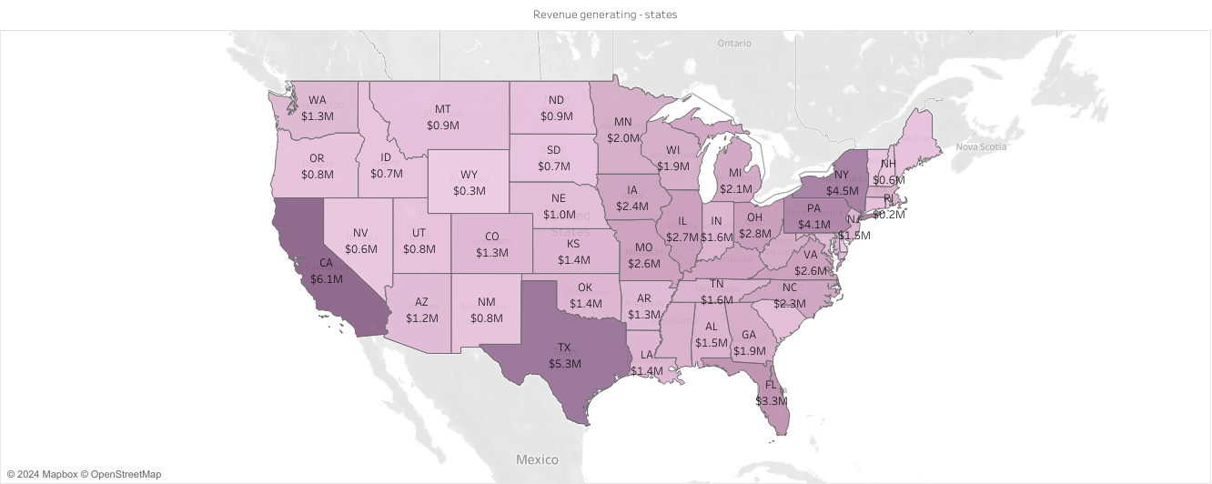

Slide 12
INSIGHTS
RECOMMENDATIONS
Target California and Florida with focused marketing campaigns to boost high-performing states
California (CA) has the highest total sales value at $6,063,357.92
Increase outreach in low-sales states like Wyoming to expand market presence
Florida (FL) shows strong sales performance with $3,325,165.46
Increase outreach in low-sales states like Wyoming to expand market presence
Wyoming (WY) has the lowest total sales value at $290,915.83

Slide 13
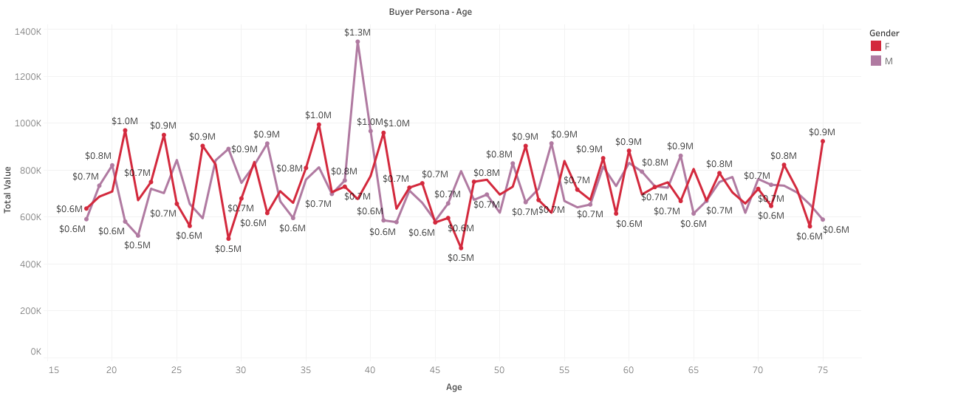

Slide 14
INSIGHTS
RECOMMENDATIONS
Customers aged 39-40 generate the highest total sales
Target marketing campaigns towards ages 36-40
Female customers consistently show higher total sales than male customers
Enhance product offerings and promotions for female customers
Sales peak significantly for ages 36-40, indicating high-value segments
Analyze and optimize product availability for top-performing age groups

Slide 15
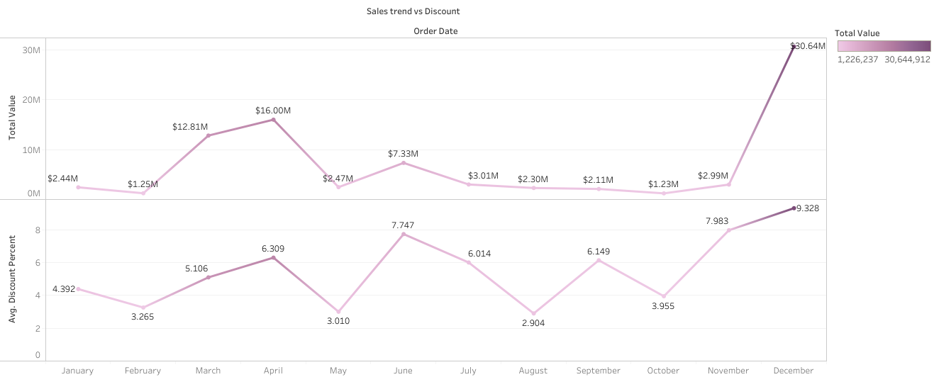

Slide 16
INSIGHTS
RECOMMENDATIONS
Mobiles and Tablets category drives the highest revenue, significantly outperforming other categories
Implement targeted discount strategies during peak sales months
Sales drop with moderate discounts (Feb, May, Aug), indicating a potential sweet spot for discounting
Increase marketing efforts in March, April, and December to capitalize on high discount periods
December's high discount strategy led to the highest sales, suggesting seasonality impacts purchasing behavior
Optimize discount rates around 5-7% to maintain steady sales growth throughout the year

Slide 17
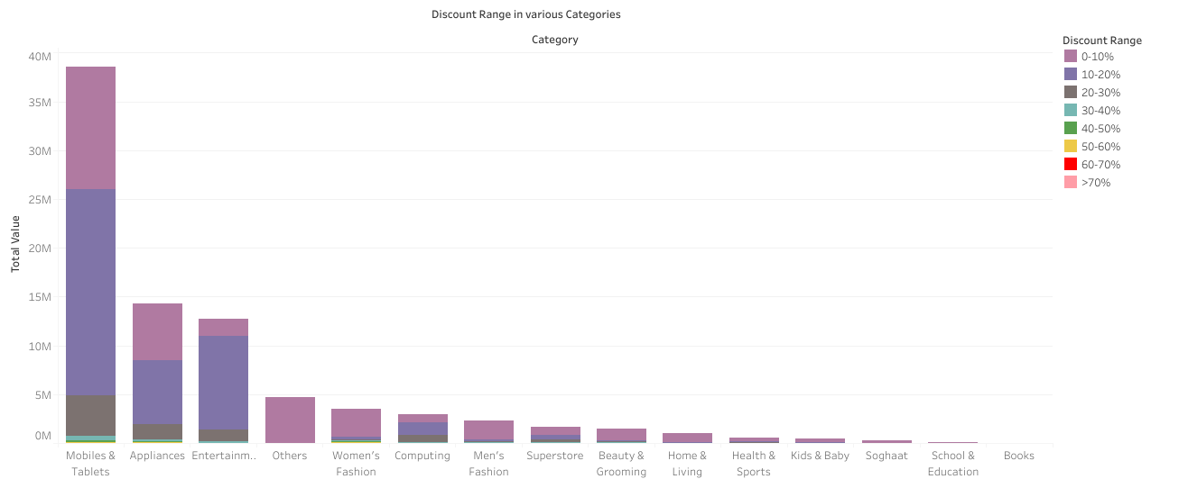

Slide 18
INSIGHTS
RECOMMENDATIONS
Low Discounts (0-10%) drive highest sales across most categories
Prioritize 0-10% discounts for consistent revenue generation
Higher discounts (30-50%) result in significantly lower sales across all categories
Limit high discounts (30%+) to clear inventory only
Women's Fashion and Electronics generate substantial sales even with moderate discounts (10-20%)
Target moderate discounts (10-20%) in high-demand categories like Women's Fashion and Electronics

Slide 19
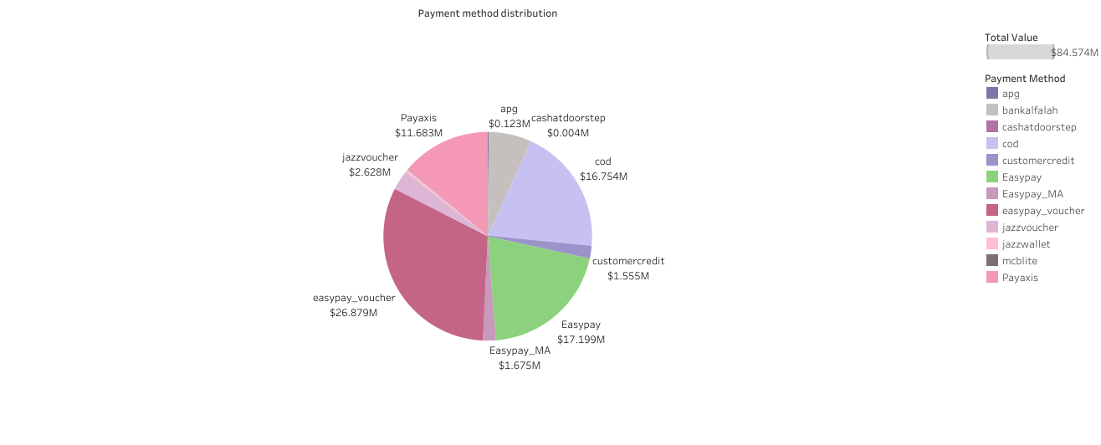

Slide 20
INSIGHTS
RECOMMENDATIONS
Easypay is the most popular payment method, contributing $26.879M and $17.199M respectively
Promote Easypay with targeted discounts to boost its adoption further
Cash on Delivery is still a significant option, totaling $16.754M
Enhance Cash on Delivery services to capture more hesitant buyers
Low adoption of Cashatdoorstep and Apg, contributing less than $0.13M combined
Introduce incentives for underperforming methods like Cashatdoorstep to increase usage

Slide 21
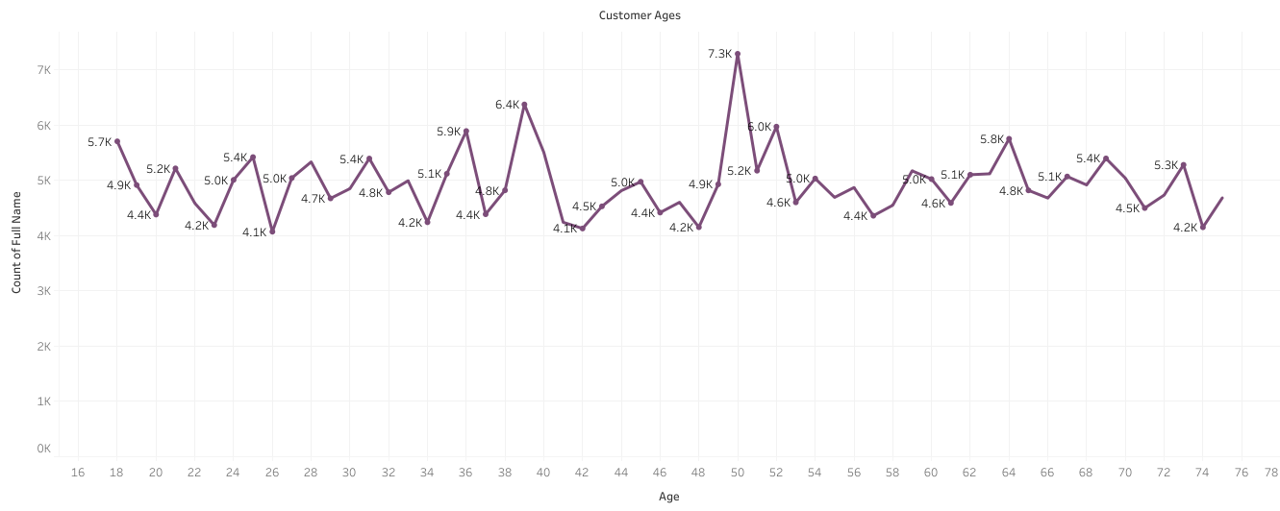

Slide 22
INSIGHTS
RECOMMENDATIONS
Focus on targeted Marketing promotions on age groups 39-50
Highest customer count at age 50 (7,293) and 39 (6,376)
Develop retention strategies and loyalty programs for customers above 50
Significant drop in customer count after age 50
Balanced distribution across age groups 20-60, indicating diverse customer base
Offer age-specific products and discounts to enhance engagement

Slide 23
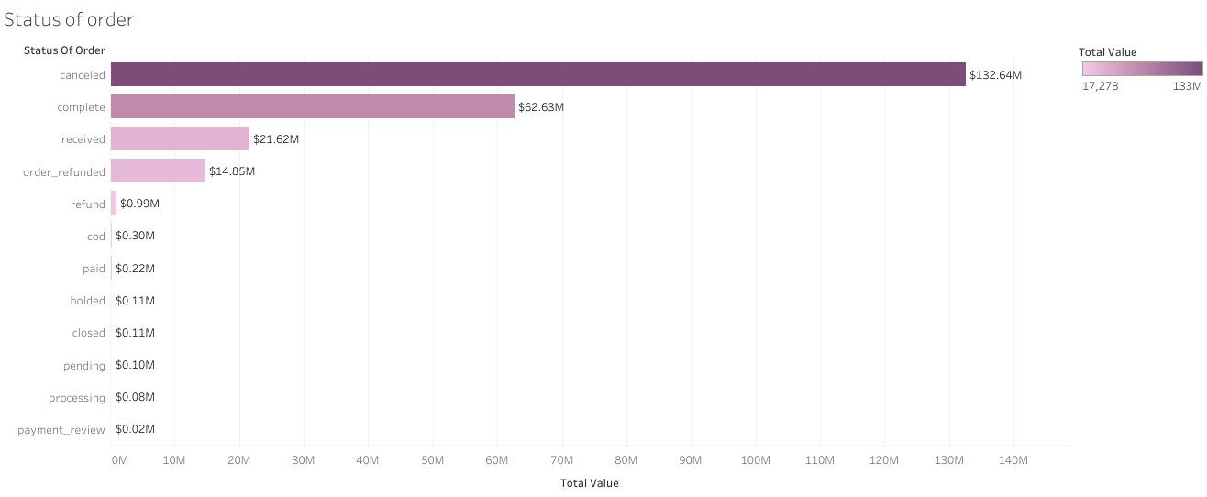

Slide 24
INSIGHTS
RECOMMENDATIONS
Implement stricter policies or improve order verification to reduce cancellations
Significant revenue is lost to refunds and cancellations.
Speed up processing and pending order statuses to improve order fullfillment
Completed orders generate the highest revenue
Address refund reasons to minimize refunds and improve customer satisfaction
Pending and hold orders impact revenue negatively

Slide 25
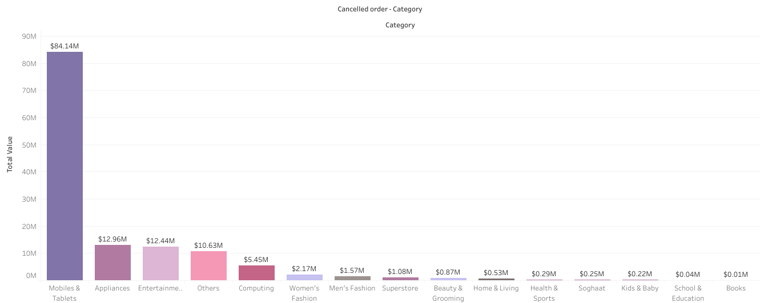

Slide 26
INSIGHTS
RECOMMENDATIONS
Mobiles & Tablets have highest total sales, which is a significant revenue contributor
Increase marketing and special offers to leverage high sales in Mobiles & Tablets
Introduce new products or bundles to enhance sales further in Entertainment category
Entertainment has Stronger sales and high potential for growth
Women's Fashion has High total sales, indicating strong market presence
Focus on trends and exclusive collections in women's fashion to sustain high sales

Slide 27
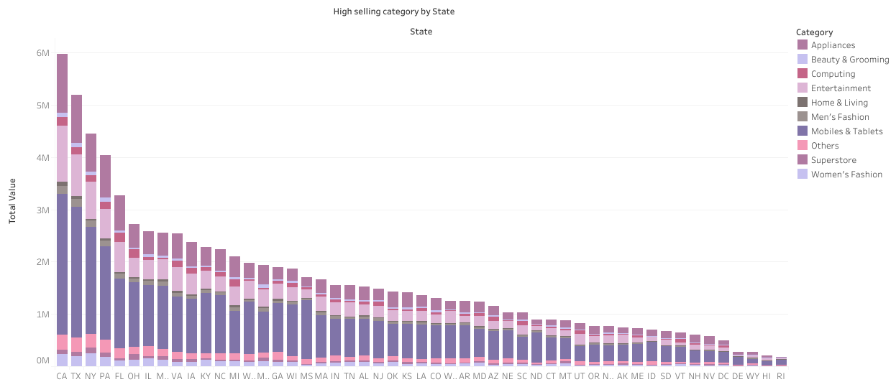

Slide 28
INSIGHTS
RECOMMENDATIONS
Mobiles and Tablets category drives the highest revenue, significantly outperforming other categories
Boost marketing for Mobiles and Tablets to capitalize on high revenue
Entertainment is the second-largest contributor to the revenue generated from each state
Expand and diversify offerings in the Entertainment category
People are purchasing general appliances, which suggests strong sales in household necessities
Promote related household necessities to leverage strong appliance sales

Slide 29
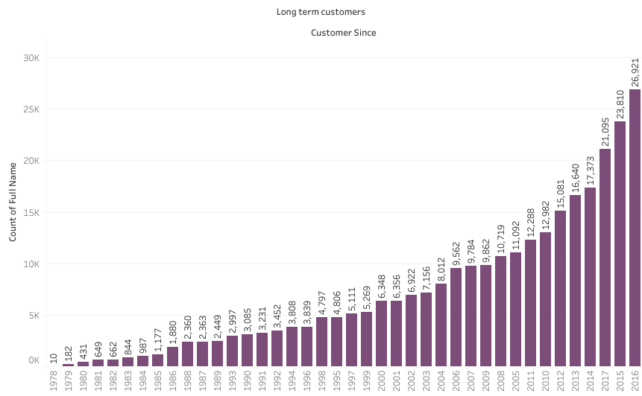

Slide 30
INSIGHTS
RECOMMENDATIONS
Focus on retaining customers from recent years with loyalty programs
Majority of customers have been loyal since 2010.
Older customers (Pre-2000) are fewer but still significant
Develop strategies to re-engage customers from the 1990s and earlier
Use historical data to tailor marketing campaigns to long-term customers
Most long-term customers date back to the 2010s

Slide 31






WAY-FORWARD
ENHANCE PROMOTIONS FOR MOBILES, APPLIANCES, AND ENTERTAINMENT CATEGORIES TO BOOST SALES
DEVELOP TARGETED MARKETING FOR FASHION AND BEAUTY SEGMENTS TO ATTRACT SPECIFIC CUSTOMER GROUPS
IMPLEMENT LOYALTY PROGRAMS FOR HIGH-VALUE CUSTOMERS AND OFFER PERSONALIZED PROMOTIONS
TARGET MARKETING CAMPAIGNS IN CALIFORNIA AND FLORIDA; INCREASE OUTREACH IN LOW-SALES STATES
OPTIMIZE DISCOUNT STRATEGIES DURING PEAK SALES MONTHS WITH MODERATE RATES FOR STEADY GROWTH
IMPROVE ORDER FULFILLMENT AND REDUCE CANCELLATIONS TO ENHANCE CUSTOMER SATISFACTION AND EFFICIENCY

Slide 32

SUBMITTED BY
MOHAMED AFSAR
BADM - MB26
MIAFSAR@GMAIL.COM
+91 9677476692
THANK YOU

